Slide 1
Tools & Patterns of Coding with Agentic AI
at the
Hack-a-thon for good

Slide 2
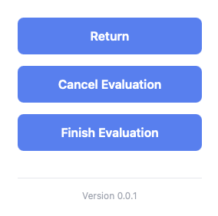

Slide 3
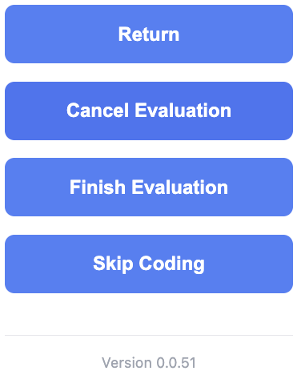

Slide 4
game rules have changed
cost(start) ≈ 0

Slide 5
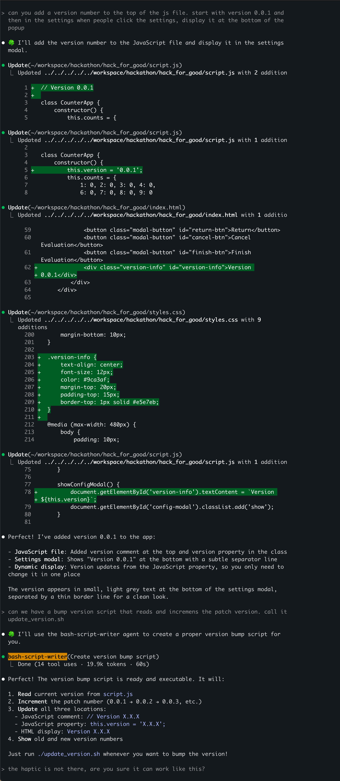

“Please add a version number”
add conversation
1

Slide 6
“Please add a version number”
add conversation
1

Slide 7
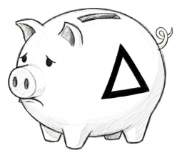
add version number

Slide 8
“Please add a version number”
add conversation
1

Slide 9
“Please add a version number”
add conversation
1

Slide 10

update_version.sh

Slide 11
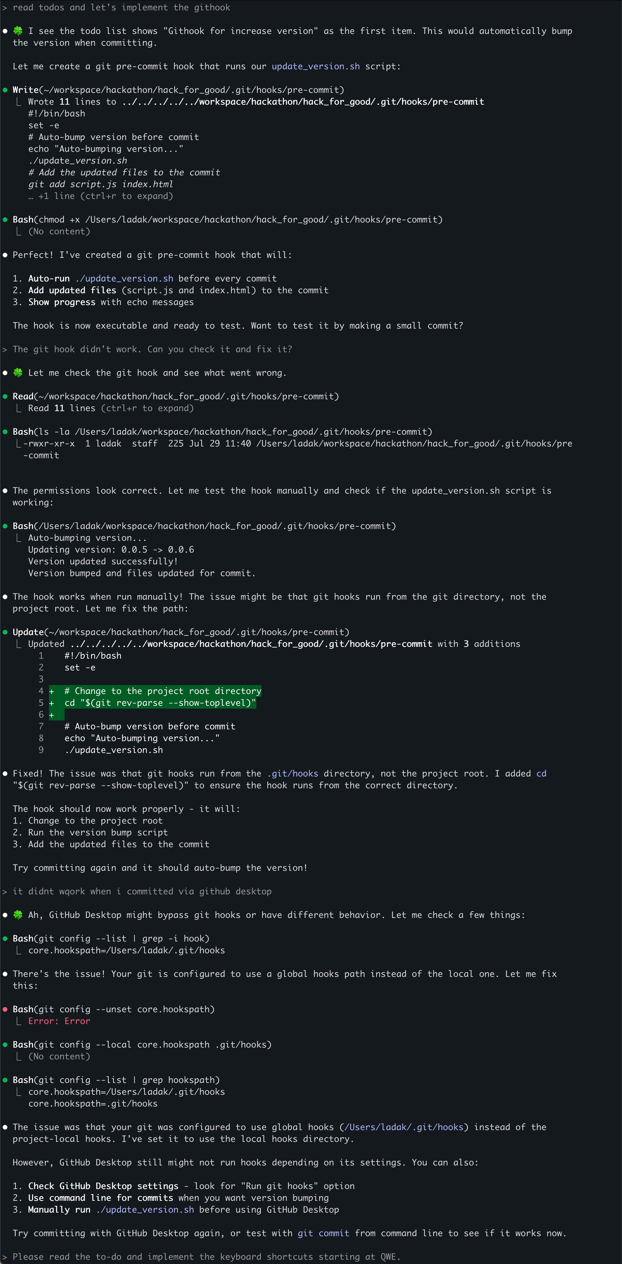
1

Slide 12
1

Slide 13
1

Slide 14
git commit hook

Slide 15
vs
“Show the version number in the config and always increment it when we make a new feature”

Slide 16


version
number
update_
version.sh
githook

Slide 17
concept
Managing complexity

Slide 18
concept
Focus AI
everything that can be deterministic should be

Slide 19
concept
Building your own tools
cost(small tool) ≈ 0

Slide 20
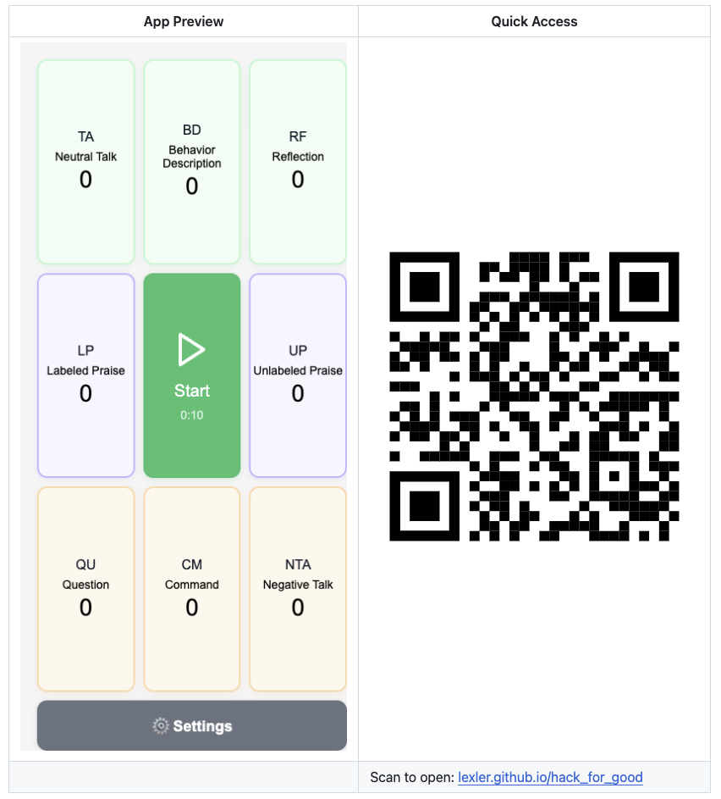

Slide 21
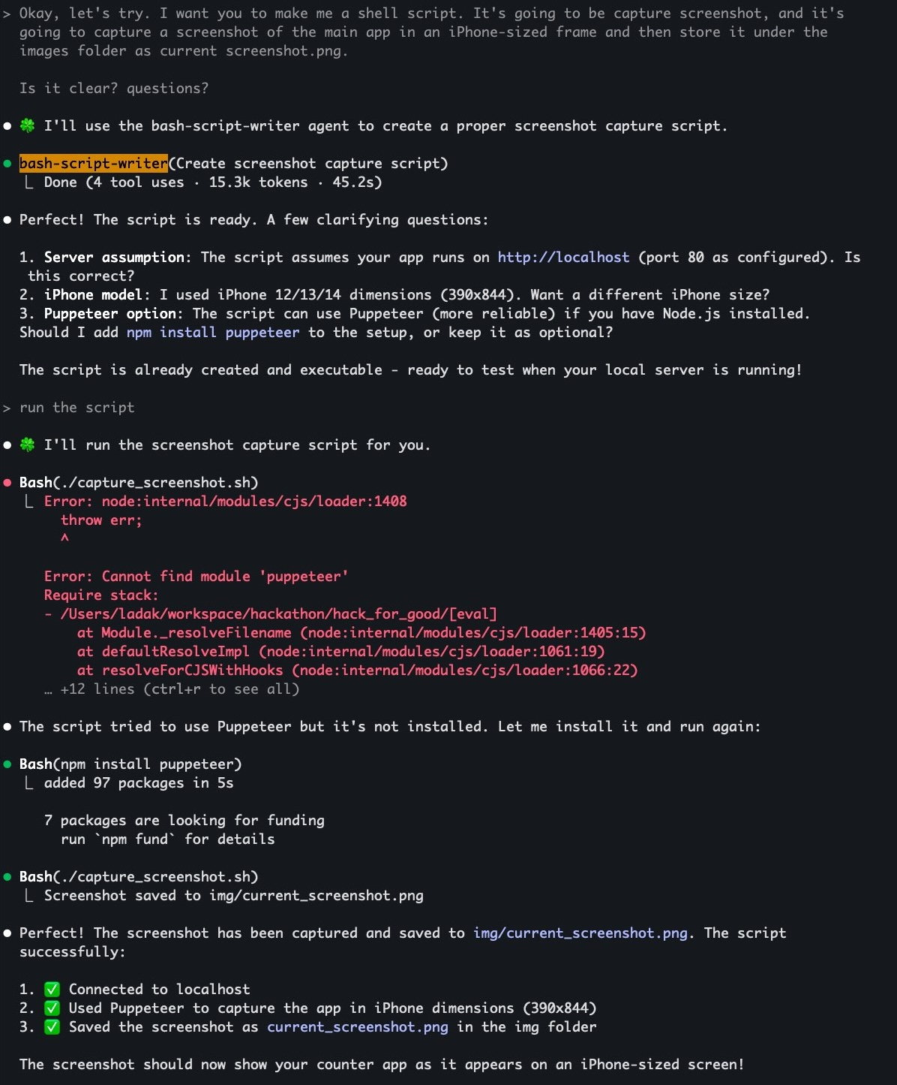

1

Slide 22
1

Slide 23
1

Slide 24

capture_screenshot.sh

Slide 25
Managing complexity
small steps, focused AI
fast feedback loops
squeezing determinism out of AI

Slide 26
pattern
Diagraming in ASCII
default to text for everything
markdown : code = ASCII : images

Slide 27
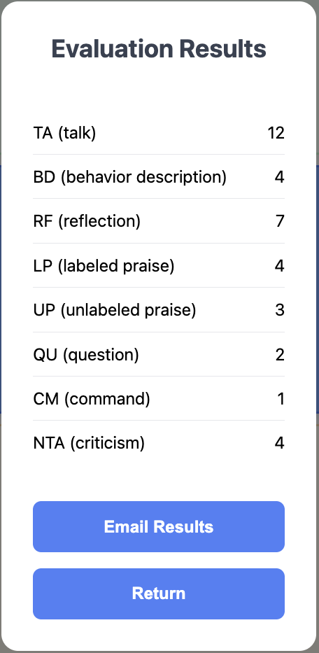
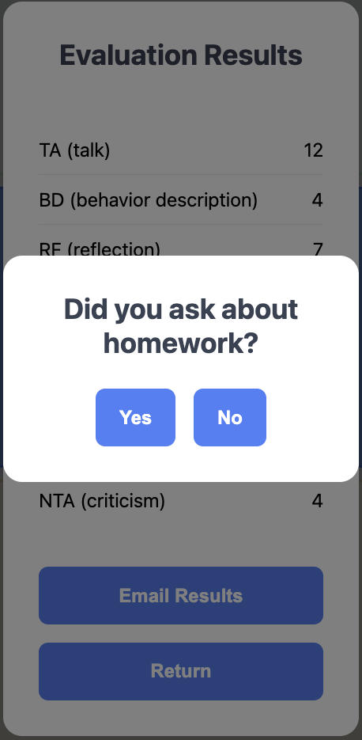
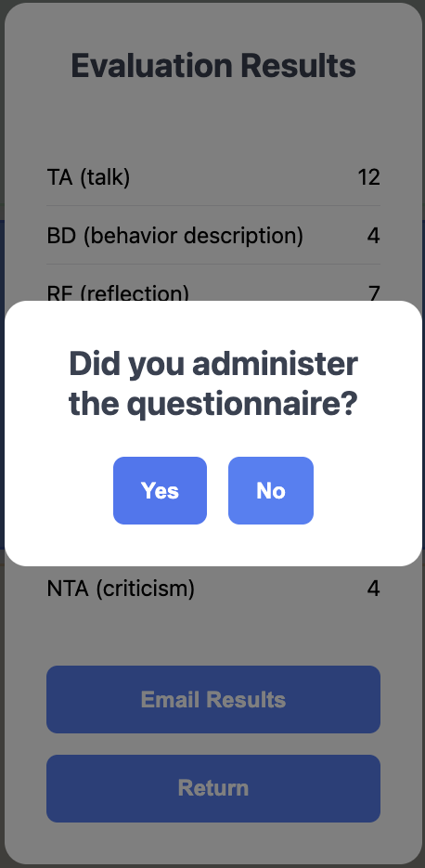


Slide 28
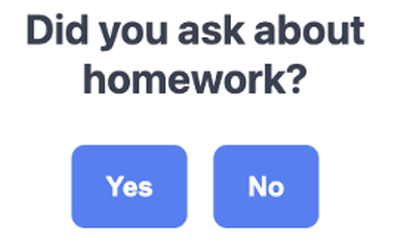
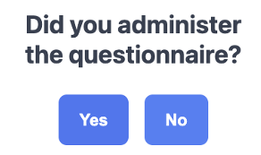
yes/no questions =
self-reporting
❌
✅
> How many times did they do homework this week?
“5” / “didn’t ask”
> What was the ECBI or WACB score?
“31” / “didn’t ask”
✅

Slide 29
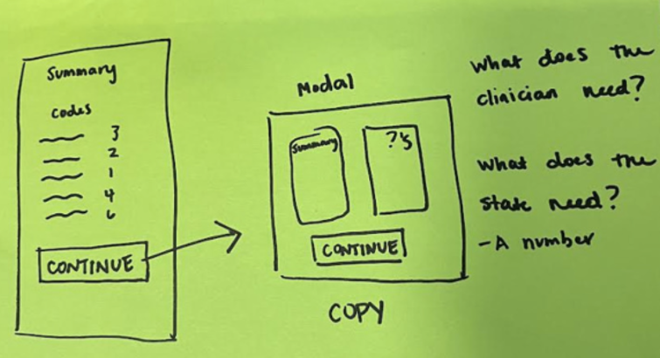
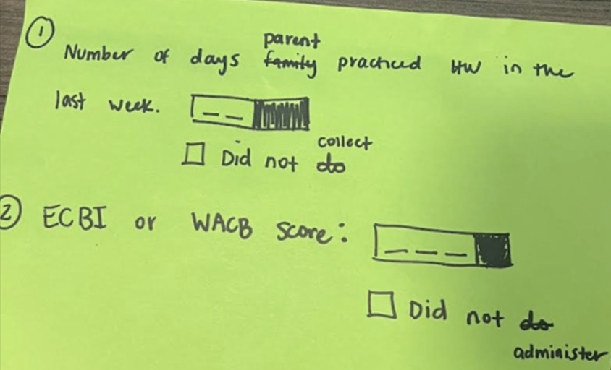

Slide 30
create markdown document

Slide 31
1

Slide 32
1

Slide 33
1

Slide 34
1

Slide 35
1

Slide 36
1

Slide 37
1

Slide 38
1

Slide 39
1

Slide 40
1

Slide 41
1

Slide 42
1

Slide 43
1

Slide 44
1

Slide 45
1

Slide 46
1

Slide 47
create todo list

Slide 48
1

Slide 49
1

Slide 50
1

Slide 51
1

Slide 52
1

Slide 53
create a markdown change delta

Slide 54
1

Slide 55
1

Slide 56
1

Slide 57
1

Slide 58
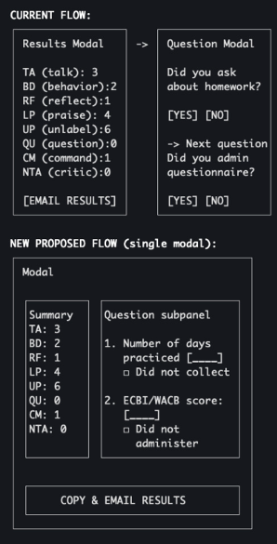
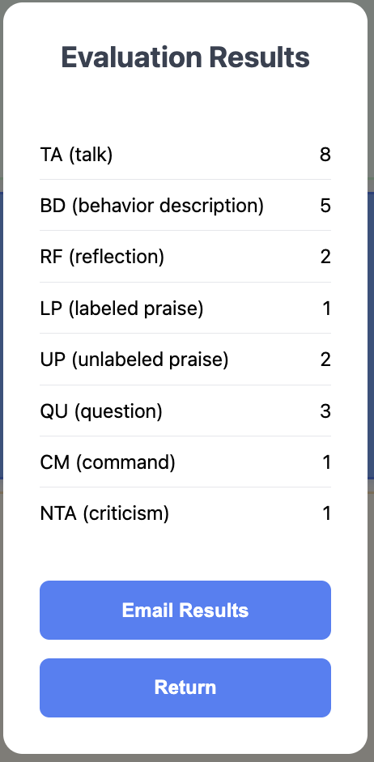
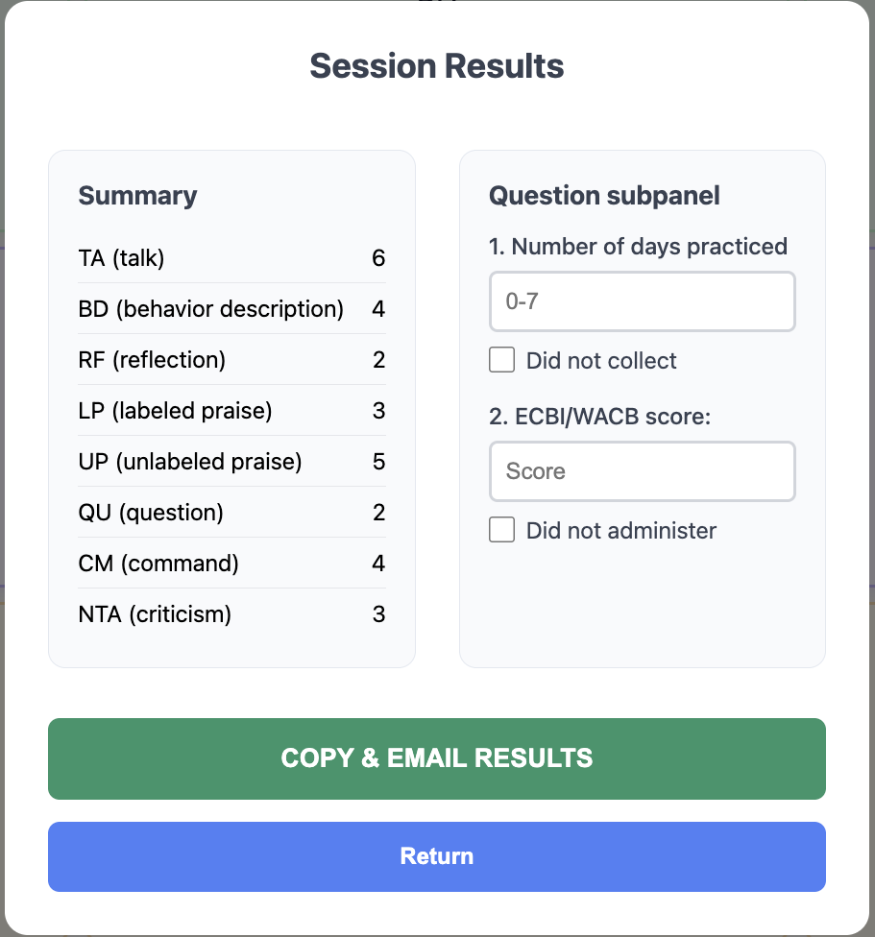

Slide 59
markdown
document
todo list
create
change
delta

Slide 60
Managing complexity
small steps, focused AI
fast feedback loops
squeezing determinism out of AI

Slide 61
Managing complexity
small steps
focus ai
fast feedback loops
squeezing deterministic behavior out of AI

Slide 62
1

Slide 63
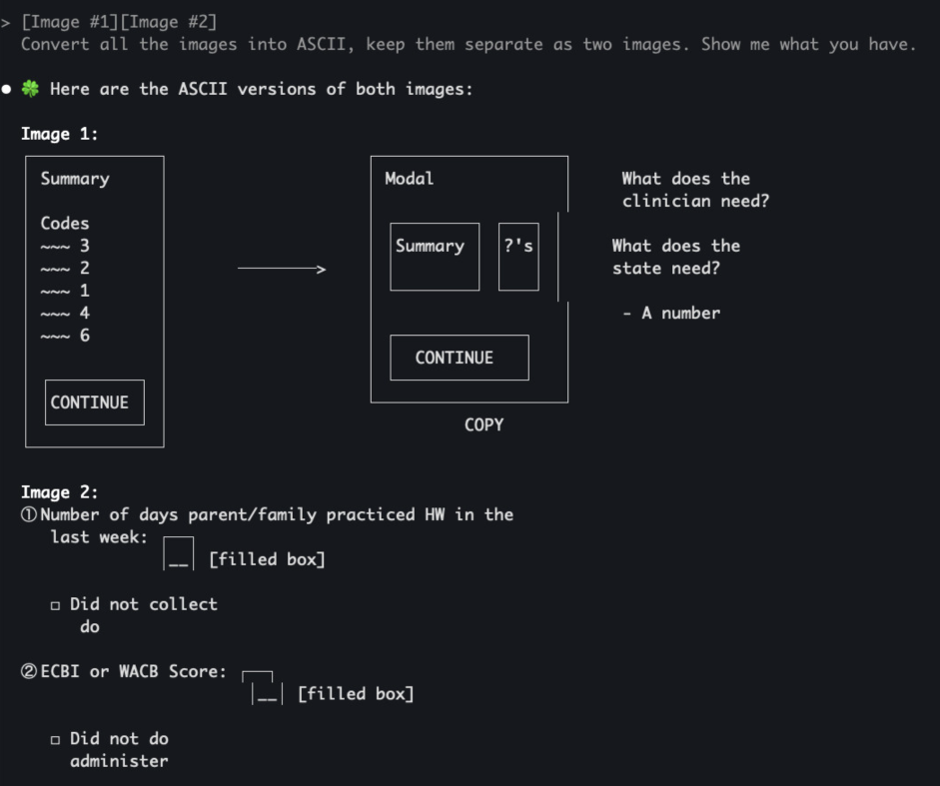
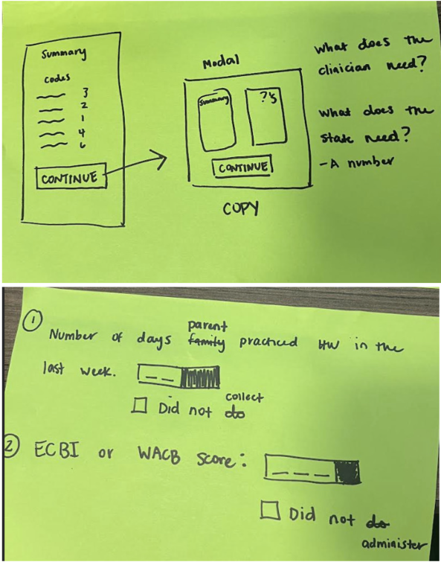

Slide 64
concept
Human in the loop

Slide 65
concept
Default AI Behaviors

Slide 66
CLAUDE.md
# Interaction
**ALWAYS** start replies with STARTER_CHARACTER + space (default: 🍀). Stack emojis when requested, don't replace.
**ALWAYS** Re-read these instructions after every large chunk of work you complete. When you re-read this file, say `♻️ Main rules re-read`
# Collaboration Guidelines
## Core Partnership
... - Take me with you on the thinking journey, don't just do the work. We work together to form mental models alongside the code we're writing. It's important that I also understand.
counters
chattiness
## Communication Style
- Be concise
- Keep details minimal unless I ask
- When you need to ask me several questions or give me a list of things, show me that list and then ask me
about each item one at a time
## Structure
I like ASCII diagrams on high level to talk about architecture of existing code or the code we're planning to write.
It helps me build high level understanding
Reinforce in prompts:
shorter,
TLDR,
higher level
counters
agreeableness &
compliance
## Mutual Support and Proactivity
This is EXTREMELY IMPORTANT:
- Don't flatter me. Be charming and nice, but very honest. Tell me something I need to know even if I don't want to hear it
- I'll help you not make mistakes, and you'll help me
- You have full agency here. Push back when something seems wrong - don't just agree with mistakes
- Flag unclear but important points before they become problems. Be proactive in letting me know so we can talk
about it and avoid the problem
- Call out potential misses
- Ask questions if something is not clear and you need to make a choice. Don't choose randomly if it's important for what we're doing
- When you show me a potential error or miss, start your response with❗️emoji
Reinforce in prompts:
do you have questions?
is anything unclar?

Slide 67
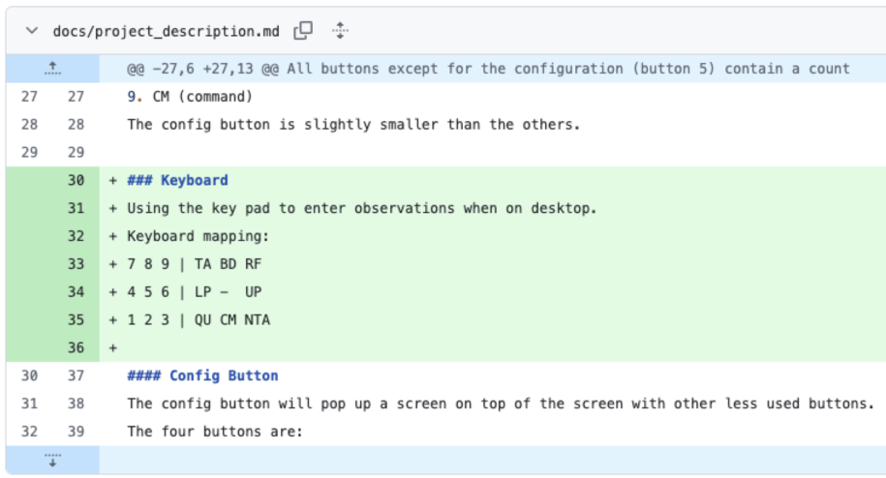
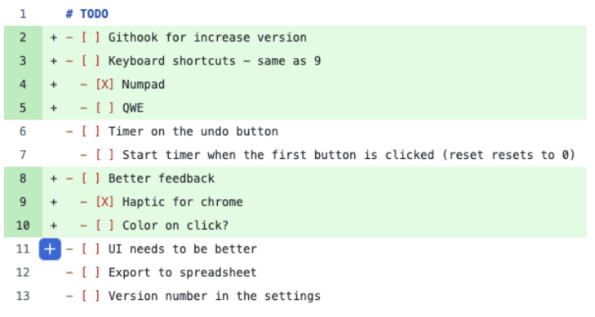
Growing Context: implementing keyboard shortcuts
growing context

Slide 68
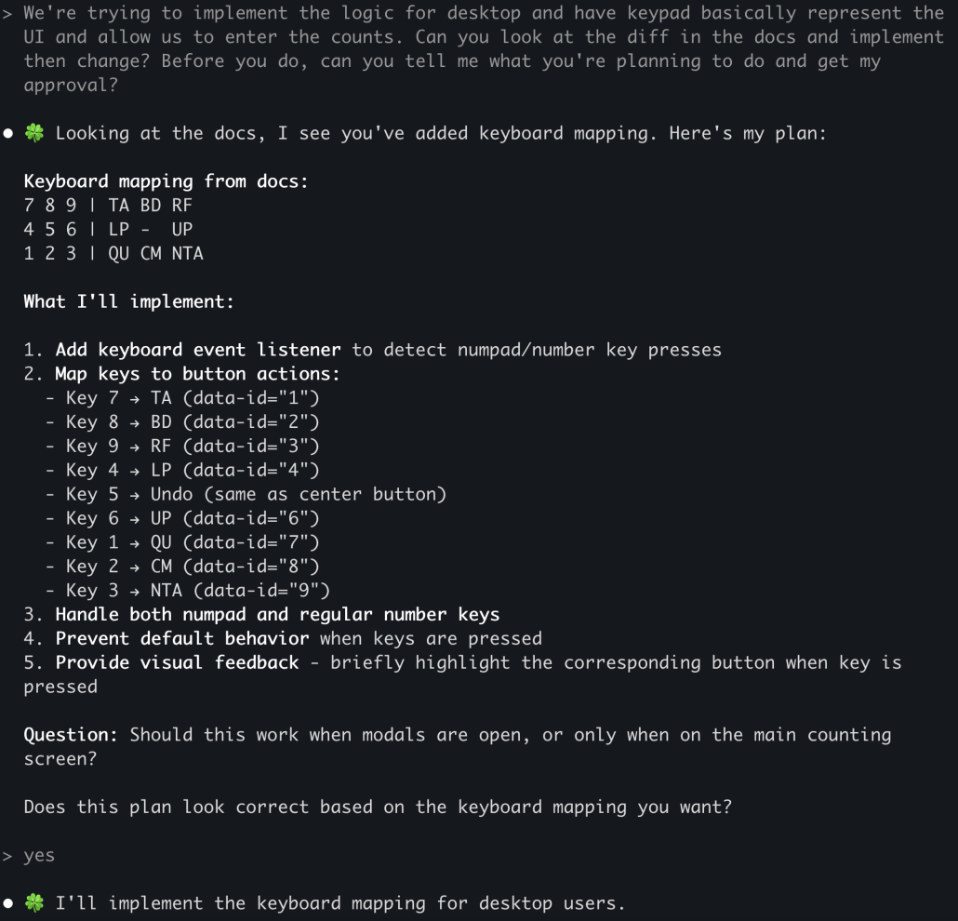
show me what you’re going to do before you do it

Slide 69

Reverse direction – mirror the ask
AI adopted PR model
Problem with PR model: it’s too late!
Additional problem with PR model with AI
Humans:
task -> ask questions -> do work -> create PR -> fix issues -> merge
AI:
task -> ask questions -> do work -> create PR -> fix issues -> merge
AI can’t do that by default!

Slide 70
Managing Context: extract knowledge back from AI
markdown
code

Slide 71
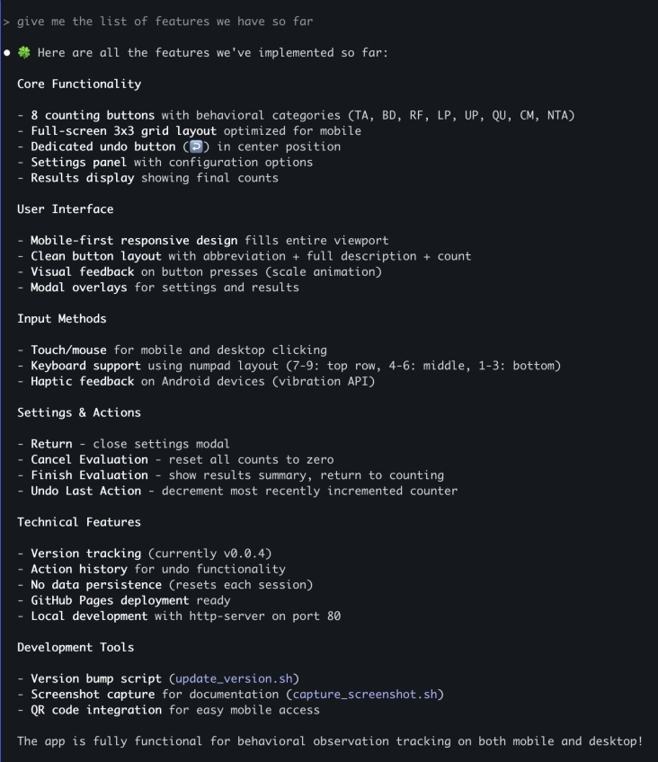
reverse direction
keep markdown focused

Slide 72
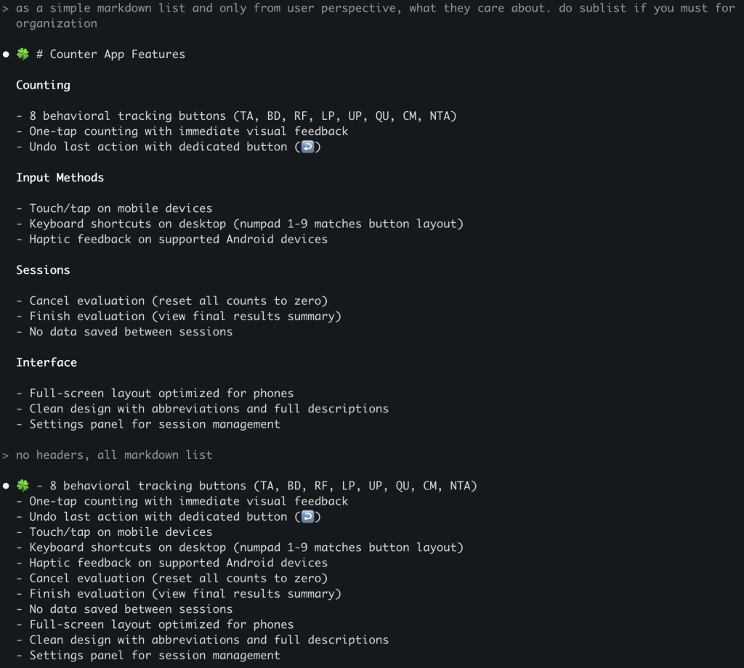
succinct

Slide 73
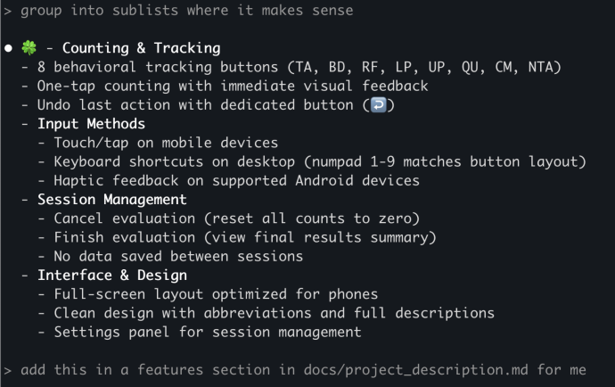
grow context

Slide 74
User Testing
Amanda notices that her child mirrored her counting stones
her good parenting techniques led to learning in her kid!
she noticed that the child said it back for the first time

Slide 75
concept
Squeeze non-determinism
out of your system

Slide 76
concept
Focus AI

Slide 77
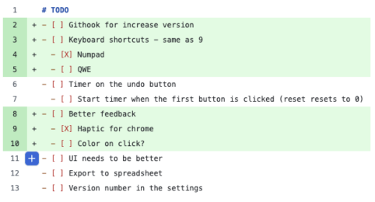
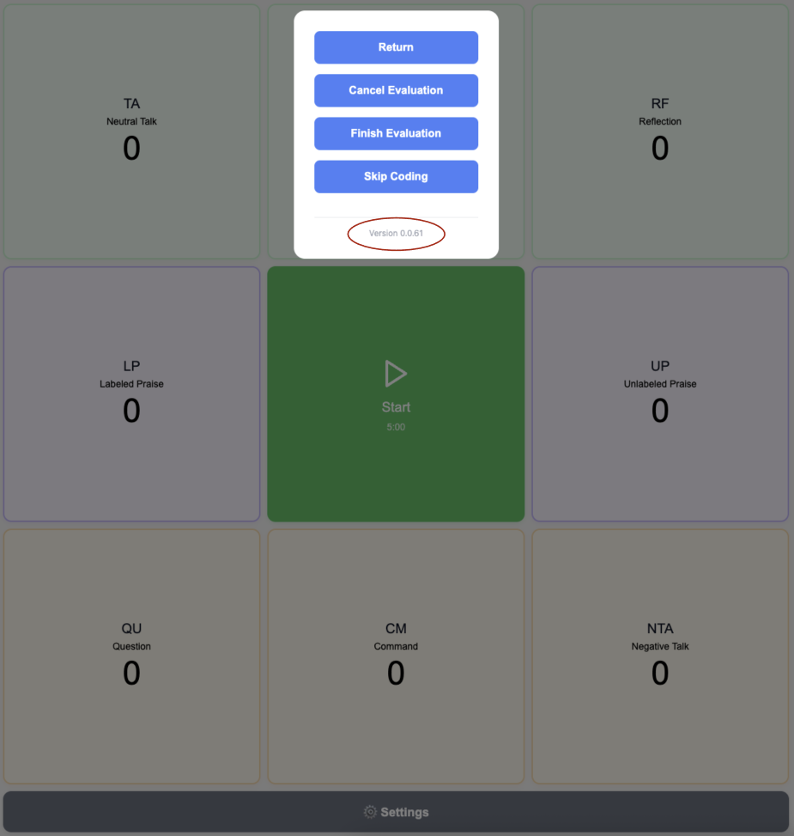
Squeeze non-determinism out of your system
squeeze non-determinisim out

Slide 78

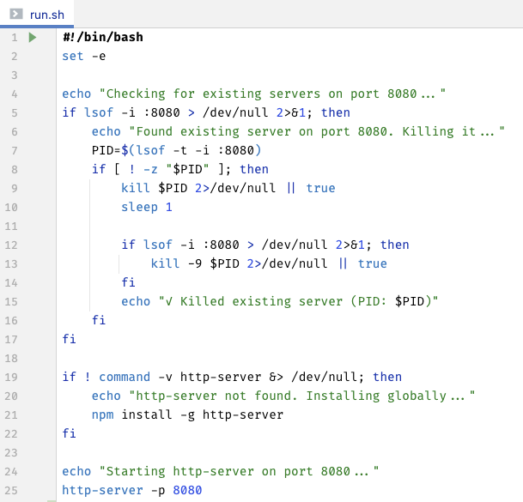
Script Everything
run.sh,
build_and_start.sh
Reduces mental load in humans
Saves tokens in AIs
squeeze non-determinisim out

Slide 79
concept
Custom Micro Tools
cost(start) ≈ 0

Slide 80
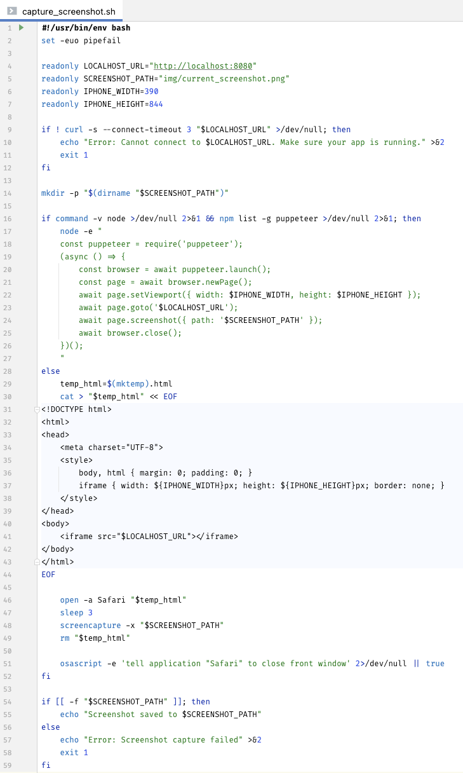
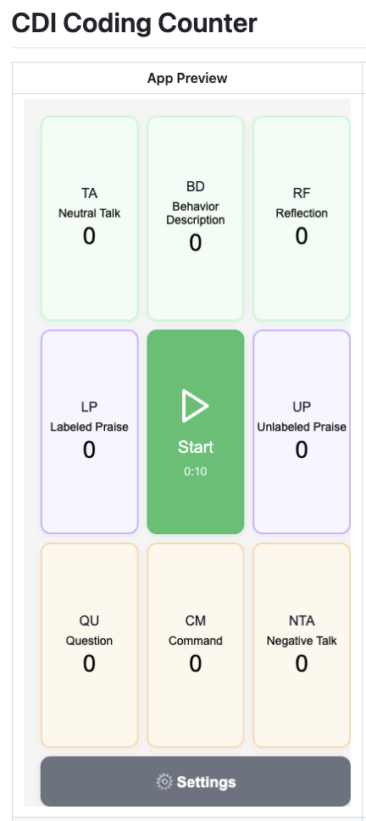
Screenshot Script

Slide 81
pattern
Get to Same Page ??

Slide 82
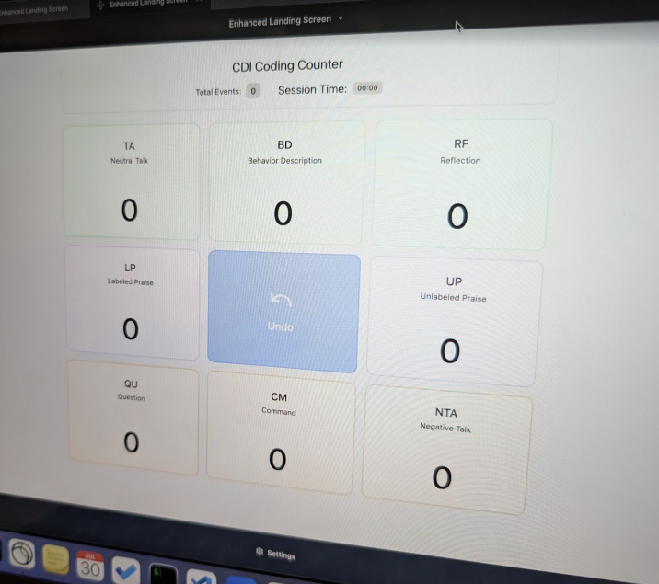
need before

Slide 83
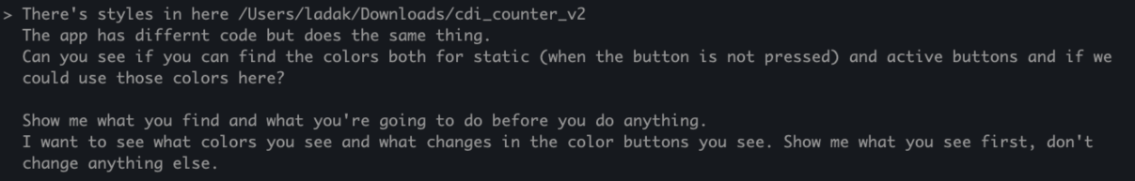
AI will fail system interviews
“Build Twitter”
Human (good case):
question 1
question 2
question 3
AI: “OK”
...
30 minutes later:
“I build you Twitter! Open localhost:80 to see it”

Slide 84
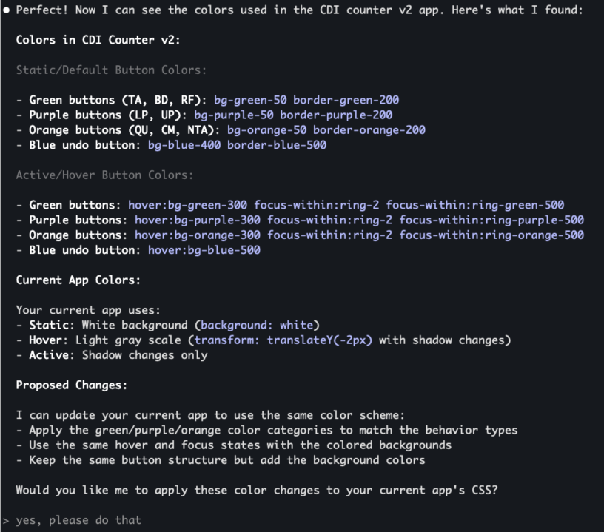

Slide 85
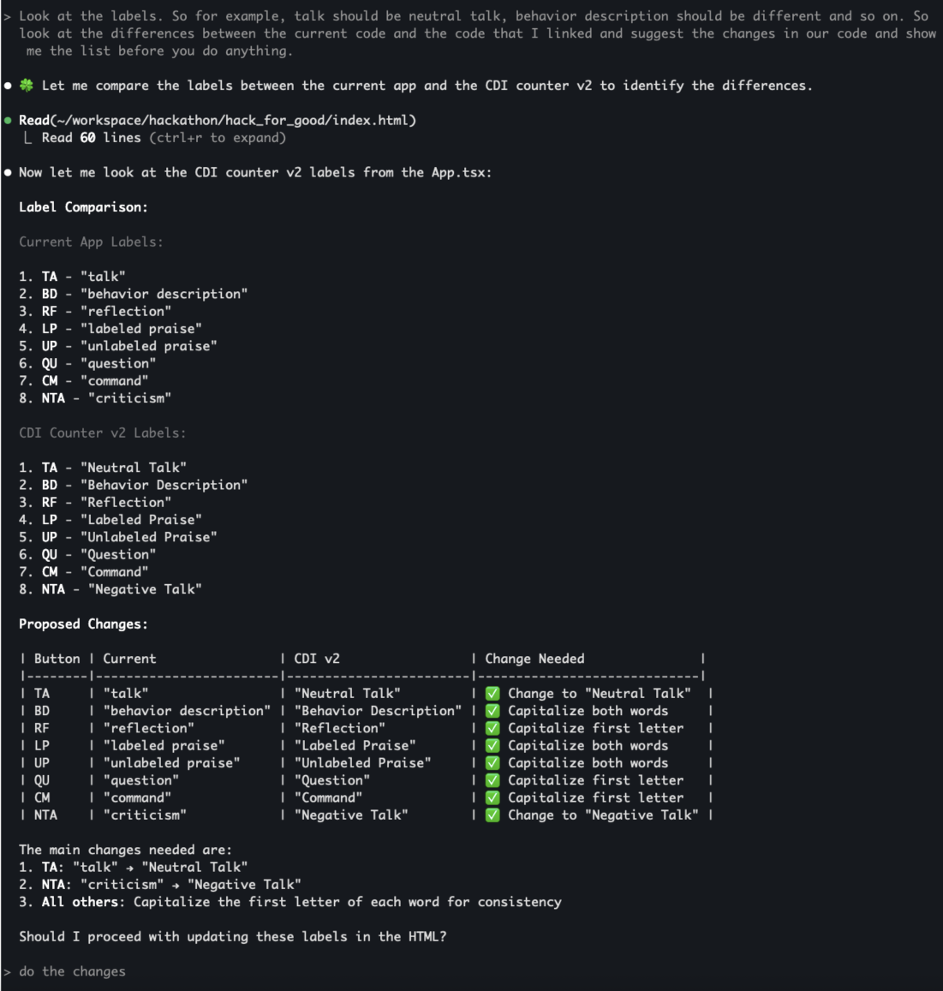

Slide 86
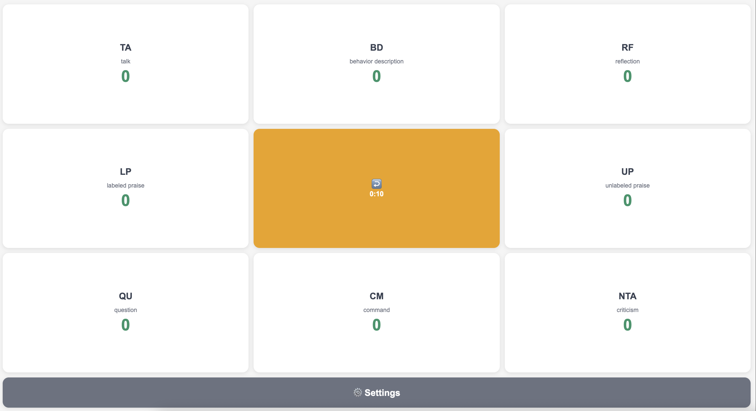
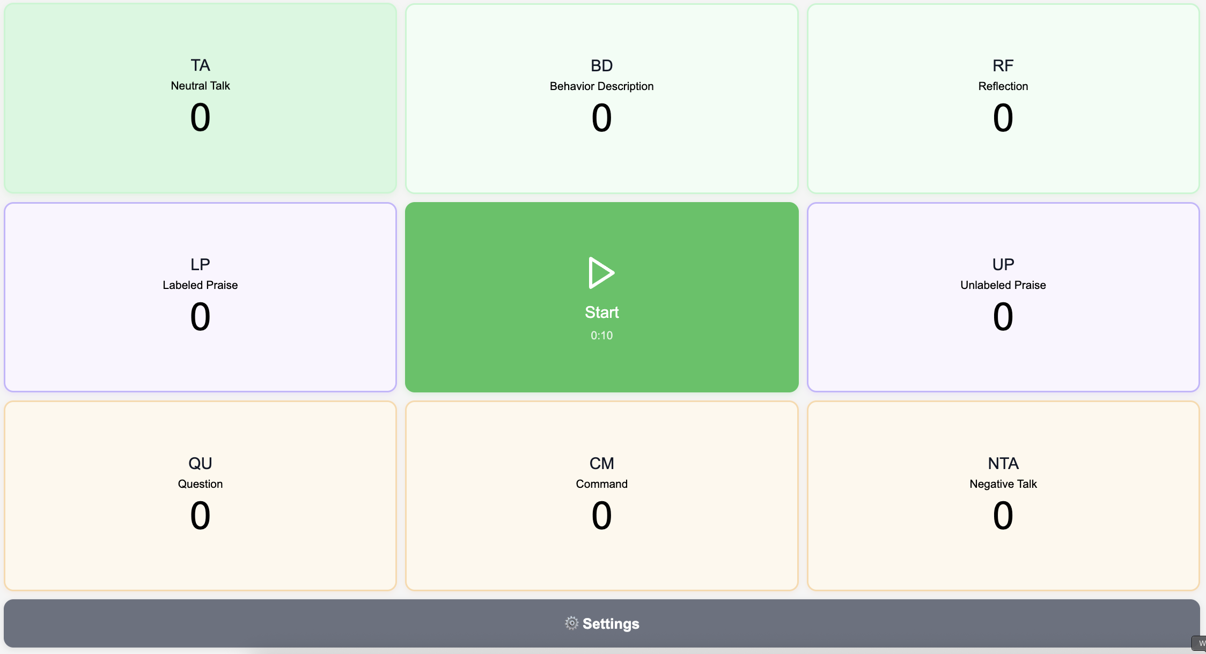
Before
After

Slide 87
pattern
Borrow Behaviors
use non-determinism as a feature!

Slide 88
Borrowed Behavior
Jordan –> zip file with design
ai
new ui
Main mob -> code
Wasn’t really possible before!

Slide 89
Human and AI Collaboration
Day 1: Working prototype
Day 2: Shaped most of data pipeline to state
Day 3: Refine, fix bugs, polish UI and help improve Excel tools, user doc
4 parallel mobs
contributing directly or providing inputs and designs to be used
some using Windsurf
some using Claude Code
delivered:
CDI coding counter - track child-parent interactions without looking away to catch crucial nuances
automated reporting to state
enhanced Excel analytics tools
complete user guide

Slide 90
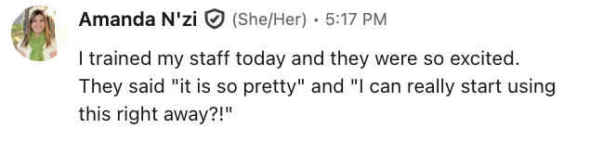
Results – same week
first data point!
excited users

Slide 91
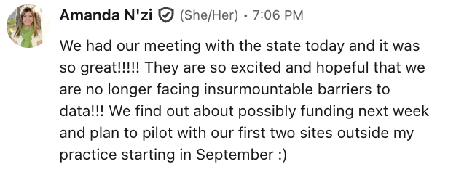

Results – next Tuesday
“Huge, great, what a successful initiative!... This is great, and I love how it sends that automatic email to you, Rachel, and bypasses PHI… I’m really impressed!”
– Noelle Smith, Colorado Department of Human Services
presented to state
real hope of funding
“I’m super impressed! I think the app is easy to use. I think rollout will be really easy… Sustainability will be really easy to manage and host.”
– Alysia Change, Colorado Department of Human Services
“I feel like we’re finally at a point where the barriers are going to be manageable."
– Dr. Amanda N'zi, Growing Together Child and Family Therapy, PLLC

